Slide 1
NE Section SRM
Orientation for New Officers and Committee Members

Slide 2
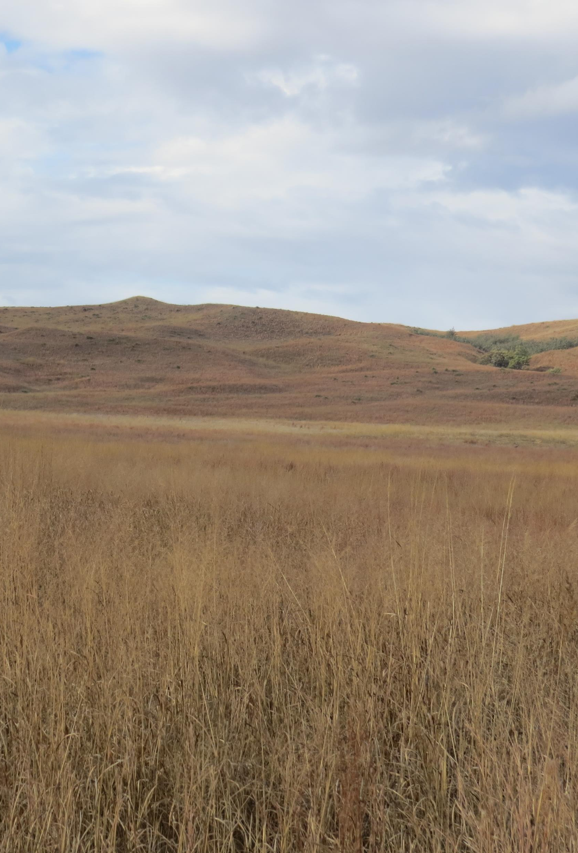
Nebraska Section Brief Facts
Organized in 1952 and incorporated as a non-profit organization in 1973.
Original Objectives: “The objectives shall be those of the parent society with emphasis on promoting greater application, interest and knowledge concerning management of grazing lands of the State of Nebraska.”
The first officers were:
President: Lorenz Bredemeier
President-Elect: Sid Salzman
Secretary-treasurer/newsletter editor: Elverne Conard
In 1956, Council members were added.

Slide 3

Source for Information in this Presentation
The primary sources for this information are the Strategic Plan, Constitution-By-Laws-Administrative Handbook and NE Section, SRM History. These documents are located on the “About” page:
https://www.nesrm.org/About.html

Slide 4
What is the Purpose of the Advisory Council of the NE Section and Who Are the Members of the Council?
According to the by-laws, “The business of the Section shall be managed, conducted and controlled by a Council of seven Councilpersons. Five of the seven are elected by a vote of the membership and two are appointed by the President”. To be eligible for the Advisory Council, the individual must be an active member of the Section.
The members of the Nebraska Section Advisory Council are:
President
Immediate Past President
President Elect
Two Council Persons (tenure is two years)
Secretary/Treasurer*
Newsletter Editor*
*These two Council members are appointed and their terms are extended at the discretion of the incoming President.

Slide 5
Duties of the Officers - President
General supervision of the Section.
Convene and Chair Council Meetings and call any needed special meetings.
Appoint Secretary-Treasurer, Newsletter Editor, and Committee Chairs.
Serve as principal contact between the Section and Parent Society.
Represent Nebraska on the International Society SRM Advisory Council or appoint a representative if unable to attend Advisory Council meetings.
Work with the Section Officers to keep the membership informed of Section activities.
Appoint necessary committees.
Preside over the Sections meetings.
Prepare “President’s Corner” article for each issue of the Newsletter.
Provide Parent Society with list of current officers and committee chairs.

Slide 6
Duties of the Officers – President-Elect
Attend and participate in council meetings.
Act for the President in his/her absence or request.
Chair the Section Annual Meeting Committee for the year following election as President-elect.
Provide Annual Meeting preliminary information (dates/location) to Web Master for update of Section Web page as soon as this information is available. Provide meeting flier as soon as the agenda, speakers and registration information are finalized
Organize the Section Dinner at the International SRM eeting the February of the year you are president-elect.
Represent Nebraska on the Parent Society Advisory Council
Begin Presidential duties at the start of new business of the annual meeting
  By this time committee chairs should be selected. Committee chairs serve at the pleasure of the president.

Slide 7
Duties of the Advisory Committee – Past President
Attend and participate in council meetings.
Represent Nebraska on the Parent Society Advisory Council
Chair the Awards Committee

Slide 8
Duties of the Officers– Secretary/Treasurer
Attend and participate in council meetings
Maintain the official records (minutes) of the Advisory Council meetings and the Section Business meeting.
Maintain financial records of the Section
Receive money for dues, meeting fees, and pay all bills as presented or required by the Council.
Perform all duties needed to maintain non-profit corporate status for the section.
Serve as a member of the Investment Committee, Nominations, and Annual Meeting Committee.
Secure and maintain liability insurance for the Section.
Reappointment can continue on an indefinite basis at discretion of current Section President.

Slide 9
Duties of the Officers– Newsletter Editor
Attend and participate in council meetings
Coordinate activities of the Newsletter Committee and prepare materials for use in the Section Newsletter. Produce a quarterly newsletter (November, February, May, and August).
Serve as ex-officio member of the SRM Information and Education Committee. ¹
Provide publicity for Section Activities in appropriate news media. ²
Solicit new memberships and notify “deleted” member of pending membership loss. ³
Issue letters of welcome to new members and encourage their participation in Section activities. ³
Reappointment can continue on an indefinite basis.
¹ This is also listed under the I&E Committee Chair duties.
² This is currently being completed by I&E Committee.
³ This is currently being done by the Membership Committee which is not listed in the by-laws. However, there has been a Membership Committee for more than 15 years. It was added to take some of the burden from the Newsletter Editor.

Slide 10
Section Committees
Section Committees are an excellent way to involve members in the Section and instill a sense of ownership in the Section and its activities.
Being a committee member provides a sense of belonging to the Section. Active members are more likely to remain members.
It is expected that individuals who chair Section Committees be members of the Nebraska Section.

Slide 11
Section Committees
The committees listed in the by-laws and/or operating in the Section today are:
1. Annual Meeting 10. Producer Affairs
2. Awards 11. Public Affairs
3. Envirothon* 12. Range Judging
4. Fund Raising 13. Range Research
5. History 14. Range Tour
6. Information & Education 15. Range Youth Camp
7. Investments 16. Scholarship
8. Membership** 17. Student Affairs
9. Nominations
*Envirothon Committee is mentioned in by-laws in Student Affairs Section, but duties are not specifically outlined as separate committee.
**The functions of the membership committee are listed under newsletter editor, but membership has been acting as a functioning committee for quite some time.

Slide 12
Section Committees
Committee Chairs may appoint/include as many committee members as needed to successfully complete their responsibilities, with approval of the Council.
All Committee Chairs are expected to provide a report at Council Meetings and the Annual Section Meeting.

Slide 13
Annual Meeting
The Section President-Elect chairs the committee and is the overall coordinator of the meeting. The President-Elect should appoint a team of individuals to assist with planning and conducting the meeting.
Suggested team members include a Program Coordinator, Facilities Coordinator, Secretary-Treasurer, Tour Organizer and others who can assist with the planning.

Slide 14
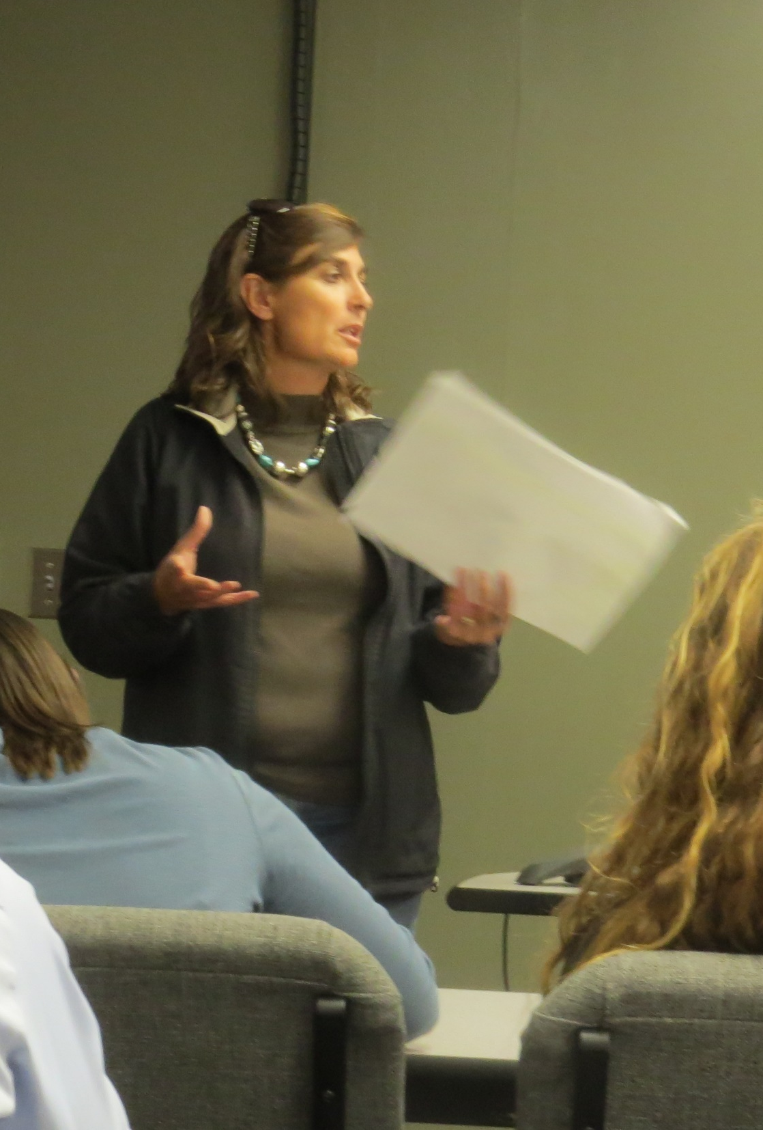
Annual Meeting Committee Duties Include:
1. Suggest or solicit bids for host city or town and coordinate plans for meeting activities in cooperation with the Council.
2. Make all arrangements for the meeting.
3. Prepare meeting program.
4. Prepare all materials needed such as programs, registration forms and meal tickets.
5. Arrange adequate personnel to handle registration and transportation.
6. Confer with Secretary-Treasurer on proposed costs including complementary items for presenters (meals, lodging, etc.).
7. Make arrangements with SRM office for Certified Range Professional/Certified Range Consultant Continuing Education Credits for the meeting and tour.
8. Consider invitation of SRM Board of Directors representative to Annual Meeting. Negotiate travel expenses as appropriate.

Slide 15
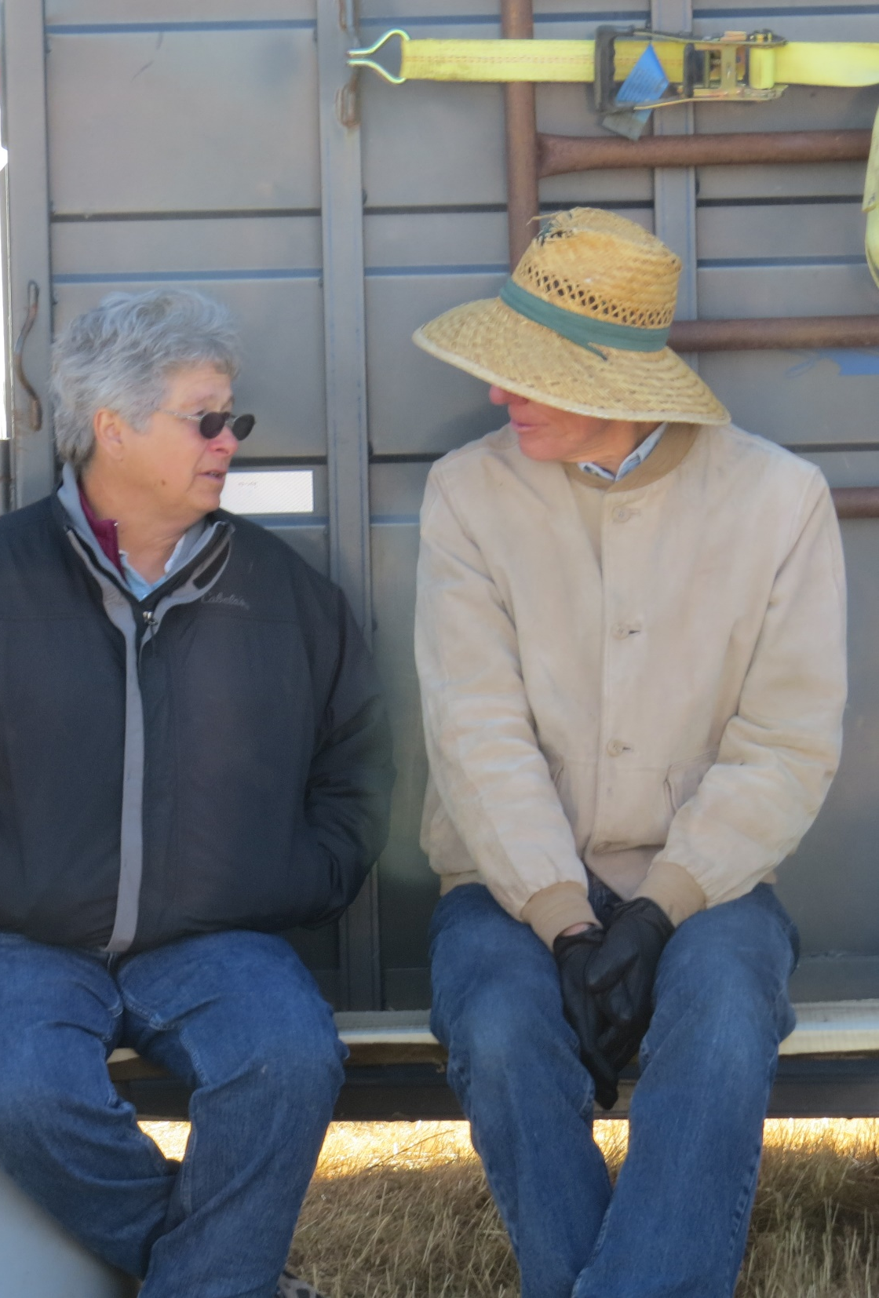
Annual Meeting
The Annual Meeting Committee plans, organizes and puts on the Section’s Annual Meeting.
The meeting format should generally consist of a Section business meeting, a technical session which includes graduate student and High School Youth Forum papers as well as a banquet to provide a presentation of awards.
A luncheon and tour may also be incorporated into the annual meeting.

Slide 16
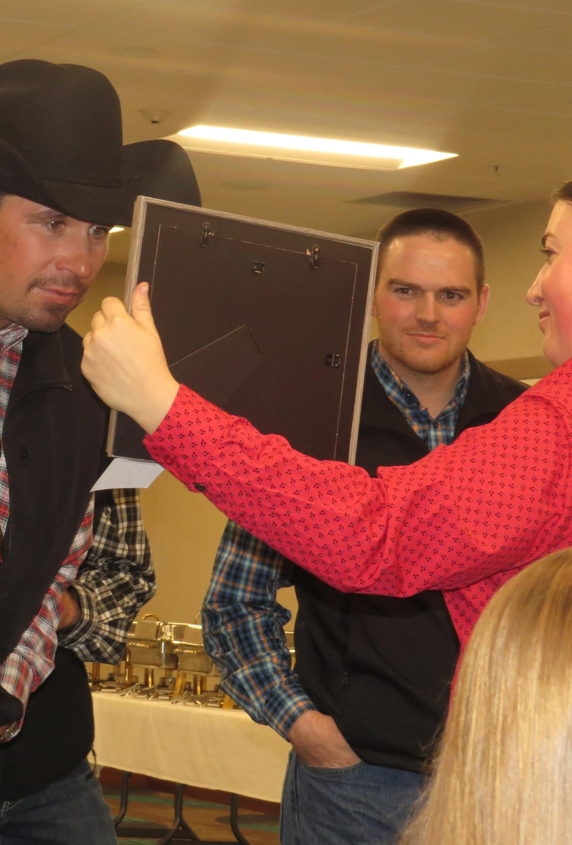
Annual Meeting Considerations
When planning the annual meeting the following items should be considered:
The banquet includes a crazy auction which is a major fund raising activity for Student Chapters.
To facilitate the crazy auction, the Annual Meeting Committee should provide:
1. An Auctioneer
2. Space for auction items to be displayed in advance of auction.
3. Adequate time ahead of the banquet to complete the crazy auction.

Slide 17
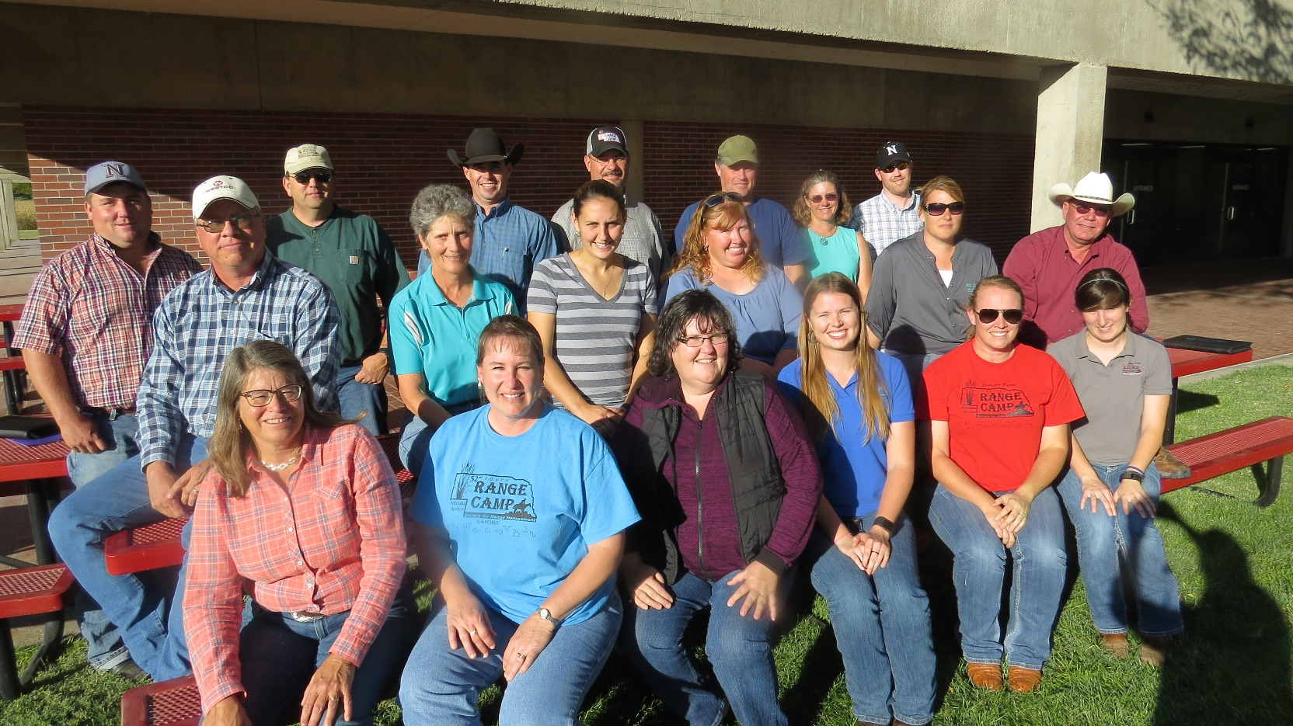
Annual Meeting Considerations
To ensure that federal agency employees receive agency approval from National Headquarters to attend the Section meeting the following items are needed at least 4 months in advance of the meeting:
1. Location of meeting.
2. Estimated registration costs
3. Preliminary agenda (invited speakers and topics)
The above information should be provided to the current NE NRCS State Rangeland Management Specialist.

Slide 18
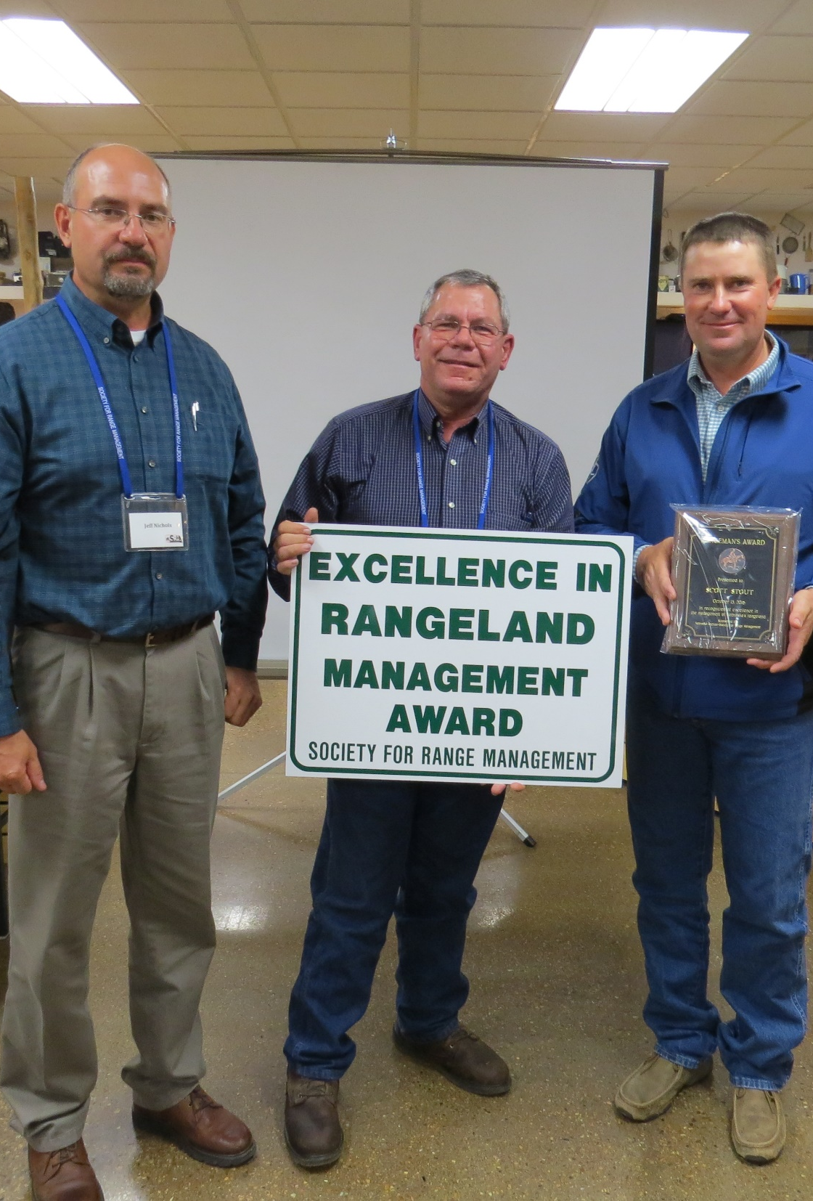
NE Section Awards
The Section has three primary awards:
1. Rangeman’s Award. Membership in SRM is not a requirement for the recipient of the Rangeman’s Award,
2. Range Management Service Award. The recipient of the Range Management Service Award must be a member of the Section.
3. Outstanding Young Range Professional Award. The recipient of this award must be a member of the Section and 40 years of age or less.
Membership may nominate an individual for a Special Award which may be approved and presented at the discretion of the Awards Committee.
Refer to Section by-laws for award criteria.

Slide 19
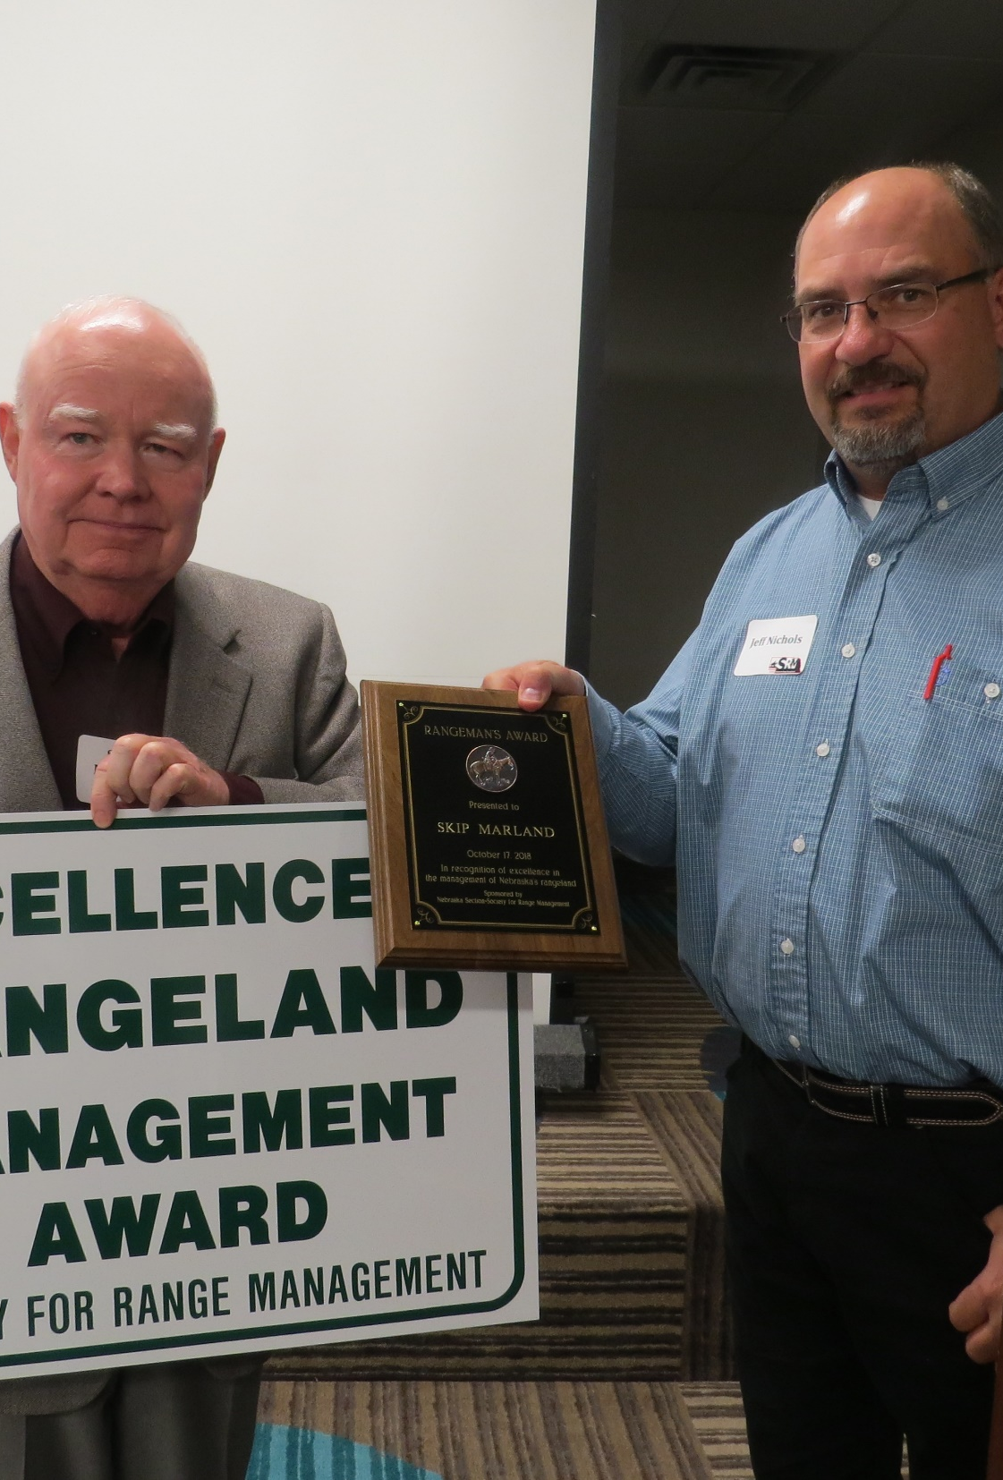
NE Section Awards
The Committee is chaired by the Section Past-President and will include two other members selected by the Chair.
Committee Duties Include:
1. Solicit award nominations in the Spring and Summer Newsletters.
2. Review nominations for the Awards, select recipients from nominations received, and seek approval of Council.
4. Order plaques to be presented to awardees at the Annual Meeting.
5. Provide biographical information to I&E Chairperson for development of news release.
6. Prepare Certificate of Appreciation for outgoing Officers.
7. Solicit and make recommendations for parent society awards as appropriate and with approval of the Council.

Slide 20
Parent Society Awards
Each Council Member and Committee Chair should identify Section members who have contributed to the SRM mission and activities and nominate these members for applicable SRM awards.
The deadline for nominations for Parent Society Awards is typically June 1st
Information about Parent Society award criteria, and nomination process can be found on the SRM website:
https://rangelands.org/committees/awards/

Slide 21
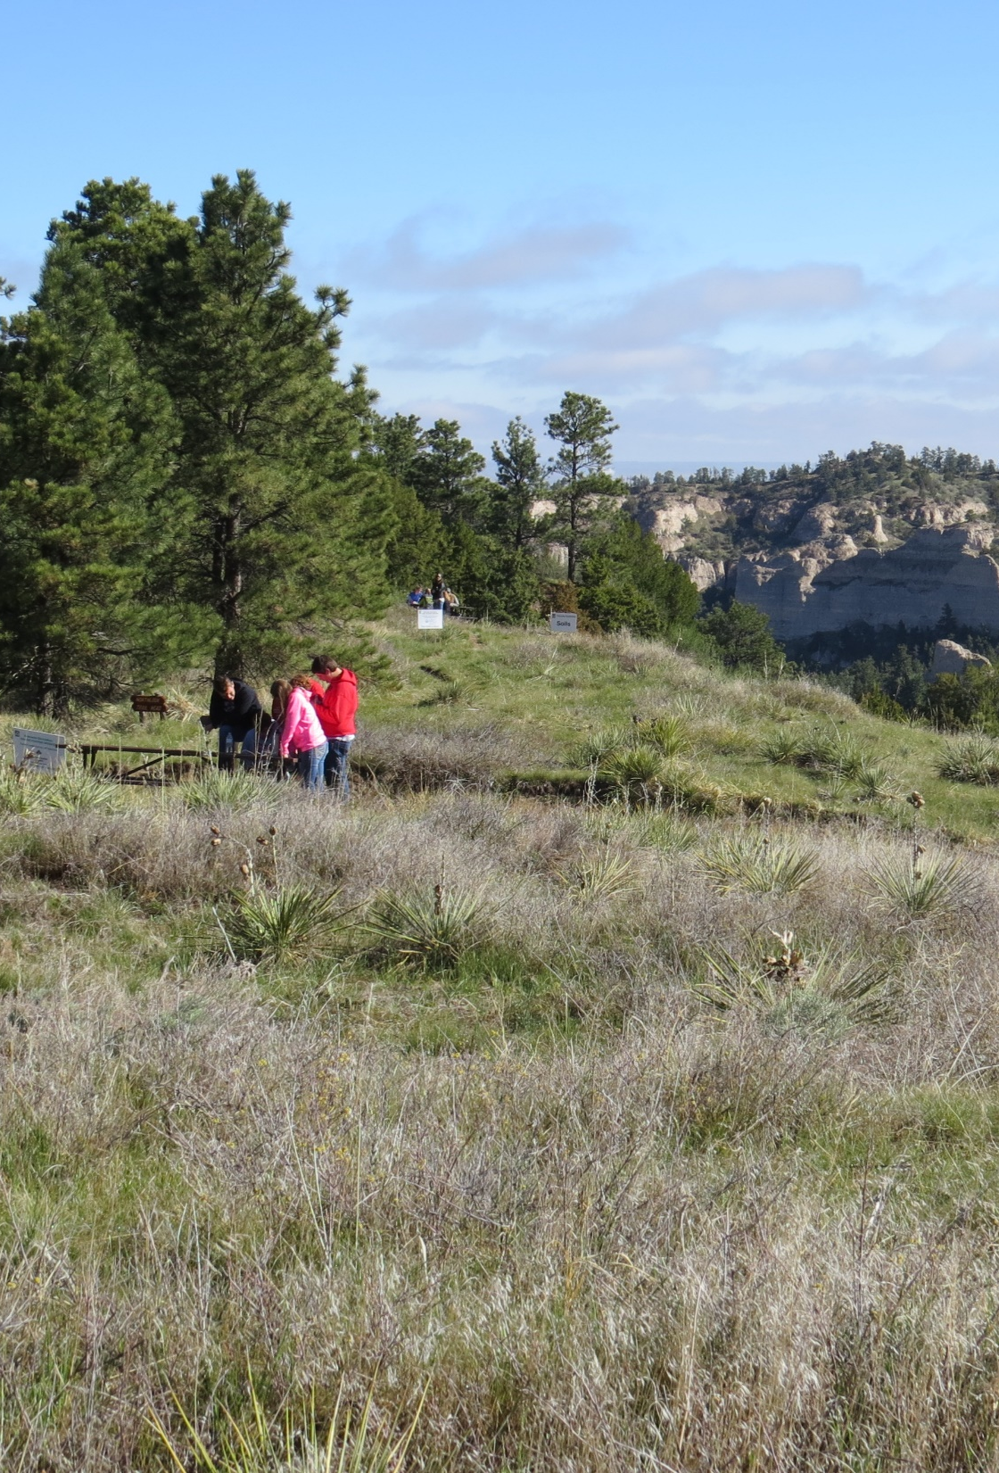
Envirothon
Nebraska Envirothon is part of a North American competition for high school students. The competition includes a variety of topics including soils, wildlife, range, forestry, policy, aquatics, and a special topic. Nebraska Envirothon is an activity of the Nebraska Association of Resources Districts.
The North American competition does not include a Range Topic. The Nebraska Section was instrumental in the addition of the Range Topic to the Nebraska Envirothon Competition.
The Nebraska Envirothon State Contest is typically held during the last week of April. The North American competition is held in July.

Slide 22
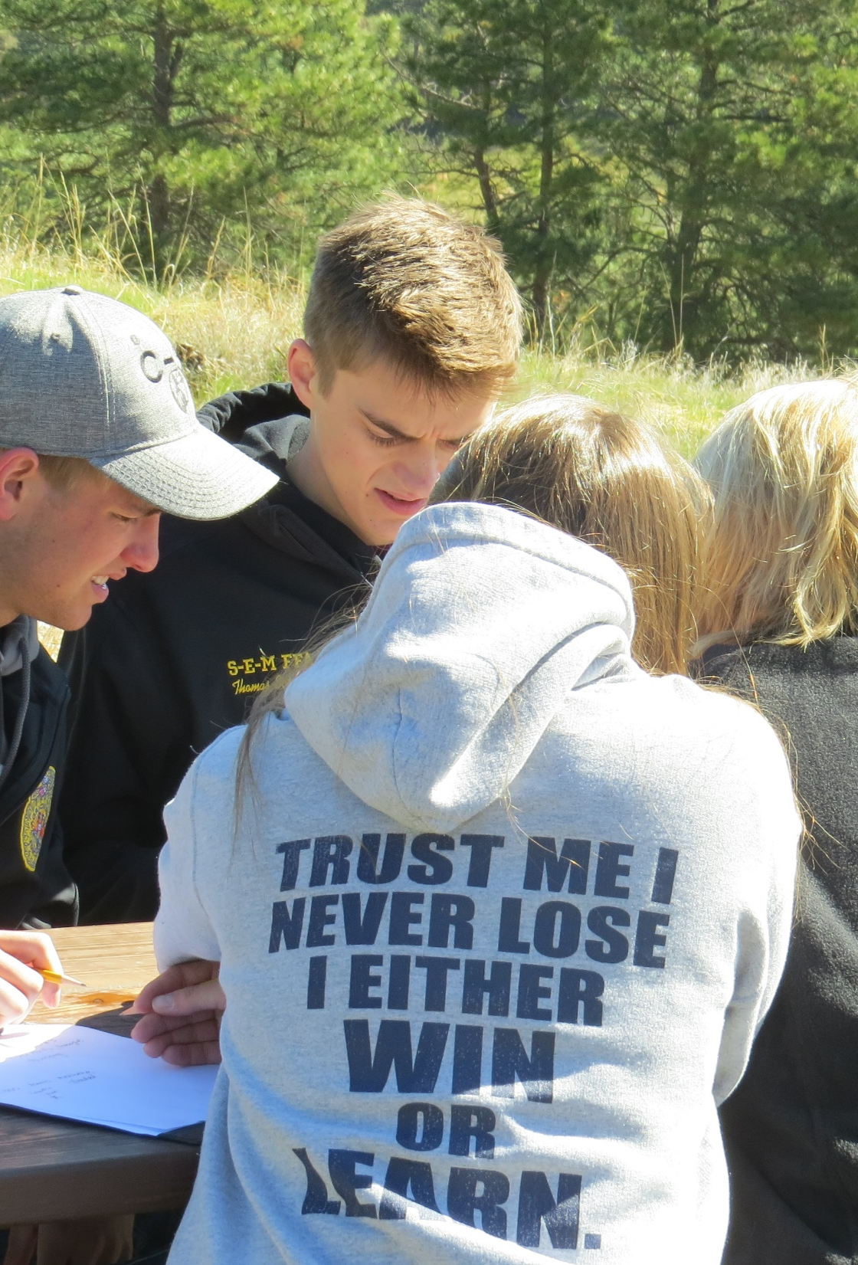
Envirothon
The Envirothon Committee consists of the Committee Chair and other persons needed to conduct committee activities and according to the current by-laws should be considered a subcommittee of the Range Judging Committee.
The Envirothon Committee Chair serves as the official test writer for the Range Topic tests for Nebraska Envirothon.
The Chair develops the Regional Range Topic Test (written test) and develops, sets up, and conducts the Range Topic test for State Envirothon. The State Test includes written and hands on activities.
Committee members review the regional and state written tests and assist with set-up of the State test.

Slide 23
Fund Raising
The Fund Raising Committee has not been active in recent years. The purpose of the committee is to maintain on-going fund raising activities for the Section.
The Committee is made up of a Chair and any others needed to conduct the committee activities. The members are selected by the Chair with the concurrence of the Section President.
The duties of the committee are to:
1. Coordinate fund raising activities for the Section.
2. Develop new or improved fund raising activities.
An example of a previous fund-raising activity is Section clothing sales.

Slide 24
High School Youth Forum
High School Youth Forum, which began as an SRM activity in 1966, is an activity of the Parent Society and is held in conjunction with the SRM annual meeting. HSYF originated from a Nebraska Section proposal to the Board of Directors in 1964.
The Forum is designed to increase the participants’ knowledge of range and natural resource management and to enhance their communications skills. The participants present a 6-8 minute formal presentation on a range related topic. A field trip, discussions with range professionals and other educational activities are included in HSYF.
Participants are selected for the Forum by their Sections.
The HSYF President and paper winner are invited back to the SRM Annual Meeting the following year.

Slide 25
High School Youth Forum
In Nebraska, per the by-laws, the top 10 range camp attendees are given the opportunity to develop a presentation which is given at the Section’s Annual Meeting. In recent years, the Co-Directors have opened this up to all camp attendees.
The top 1 or 2 presenters (depending on anticipated costs for HSYF attendance) are eligible to attend the HSYF. The Section pays for the transportation and hotel rooms for the Nebraska students attending the HSYF.
National rules are that a maximum of 3 delegates may be sent by a Section. This maximum does not include the previous year’s HSYF president or paper winner.
In past years, Nebraska has been the home section of HSYF presidents and paper winners. When this occurs, additional costs are incurred by the NE Section.

Slide 26
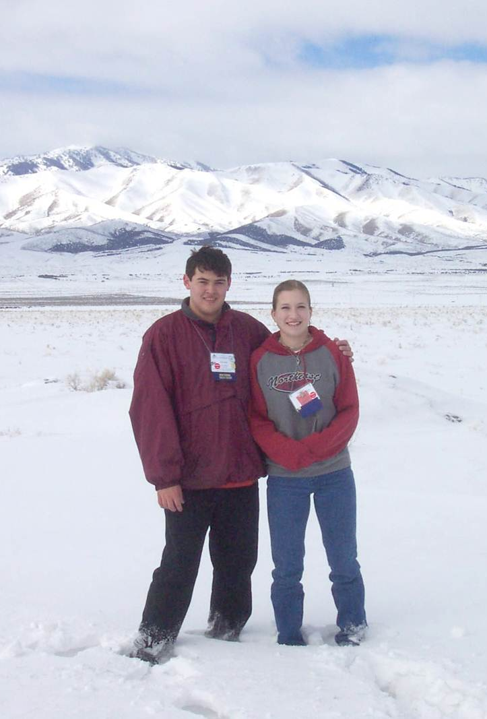
High School Youth Forum
Per Section By-Laws, HSYF expenses should be a line item in the Range Youth Camp budget and income from the camp should cover the cost of sending the Section’s delegates to HSYF.
.

Slide 27
History
The History committee is responsible for maintaining a record of the Sections activities and official acts. The Chair is the Section Historian and should have a working knowledge of the Section and its activities. The Chair shall select additional committee members as needed.
The Historian will:
1. Actively solicit and archive all information, publications, documents and other materials deemed pertinent to maintaining the Section history.
2. Prepare documents needed by the Council to appropriately disseminate the historical information.
3. Prepare an article for each newsletter entitled “Do You Know What Happened in the Nebraska Section Five Years Ago, Ten Years Ago, etc.”
4. Annual update a master file which will be used to update the Nebraska Section History. The Section History is located on the NE Section website: https://www.nesrm.org/

Slide 28
Information and Education
The responsibility of the I&E Committee is to promote a wider recognition of the role of SRM as an organization made up of informed, interested people concerned with range resource management. The committee chair will select additional members as needed.
Duties of the I&E committee:
1. Chair of the committee serves as a member of the SRM I&E Committee.
2. Develop I&E programs for Nebraska with approval of the Council.
3. Implement I&E programs developed by SRM in Nebraska.
4. Recently, the I&E Chair has developed press releases about Section activities such as Range Youth Camp, Range Judging, Annual Meetings and Award Recipients.

Slide 29
Investments
The Investment Committee is responsible for making proper arrangements for investment of funds designated for investments. The primary source for current investment funds were from proceeds from the 1999 SRM Annual Meeting hosted by the Section in Omaha and the 1991 SRM Summer Meeting hosted by the Section in North Platte.
Currently, the scholarships are funded through the Section’s investments.
Current sources of investment funds include:
Annual donations from an anonymous donor
UN-L and CSC Range Management Clubs which provide 10% of the proceeds raised from the Crazy Auction at the Nebraska Section, SRM annual meeting.

Slide 30
Investments
The Duties of the Investment Committee are:
1. Conduct all business related to investment of and disbursement of investment funds including forwarding reports and tax documents to the Section Secretary-Treasurer.
2. Determine the dollar amount of funds available for scholarships in a given year and report to the Chair of the Scholarship Committee the recommended amount and number of scholarships to be awarded that year.
3. Determine the appropriate dollar amount and number of graduate student travel grants to be awarded in a given year.

Slide 31
Membership
The Membership Committee promotes membership in SRM.
The Duties of the Membership Chair Include :
1. Solicit new memberships and notify “deleted” member of pending membership loss.
2. Issue letters of welcome to new members and encourage their participation in Section activities.
3. Other activities such as reminder emails, to encourage membership renewals.
4. Work with newsletter editor to ensure that the membership/mailing list is current and up-to-date.
The Membership Committee Chair is a member of the Parent Society Membership Committee.

Slide 32
Nominations
The nominations committee is responsible for soliciting individuals to run for the elected Council positions.
The nominations committee should be made up of the chair and at least one other member.
Nominations should be finalized by July 15th.
Resumes of the candidates should be provided to the Newsletter Editor so that the resumes are included in the late summer newsletter.
The nominations committee shall send a ballot (paper or electronic) to all members of the Section to be returned on or before October 1st.
Ballots are counted by the Secretary-Treasurer and the count verified by members of the nominations committee.
At the present time, the SRM office assists with the electronic ballot process.

Slide 33
Producer Affairs
The producer affairs committee is responsible to develop and recommend SRM action to improve professional standards and professionalism in range management.
The committee is a correspondent and liaison for the Nebraska Section with producers as needed.

Slide 34
Public Affairs
The Chair of the Public Affairs is the senior Councilperson and the committee should include at least one member with linkages to the State Legislature.
The duties of the Public Affairs Committee are to:
Keep Section membership to date on issues of state-wide scope that relate to the interests and concerns of the Society.
Keep informed and monitor new and proposed legislation that deals with matters related to rangeland, rangeland resources and the environment.
Gather facts on issues, evaluate proposed action and submit recommendations to the Section President.
This Committee has been inactive for a number of years.

Slide 35
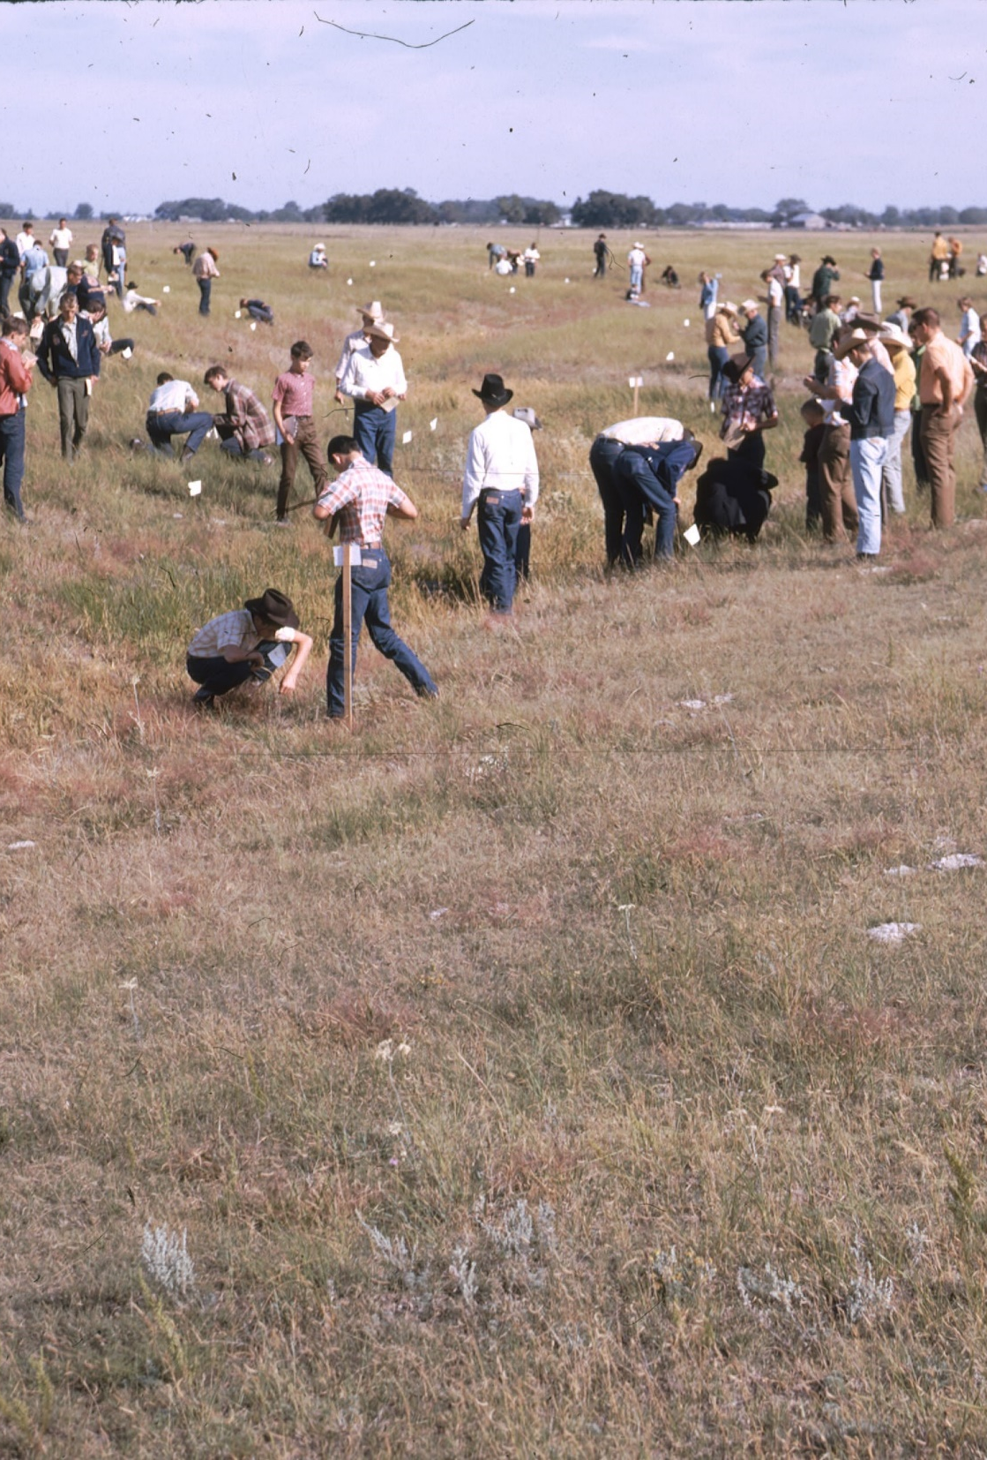
Range Judging
The first Range Judging Contest was held in 1954 and was one of the first significant activities of the Nebraska Section. This contest was organized by Donald F Burzlaff (UN-L) and Lorenz Bredemeier (SCS) in the Ainsworth area and 25 students participated in the contest.
For several years, Range Judging Contests were only held in the western 2/3 of the state. In 1966, Peter Jensen held range judging training schools for ag teachers and extension educators in the eastern 1/3 of the state and shortly thereafter, Range Judging was expanded to cover the entire state.
In 1990, a travel scholarship was established to support travel to the Old West Regional Range Judging contest or National Land, Pasture and Range Judging Contest.

Slide 36
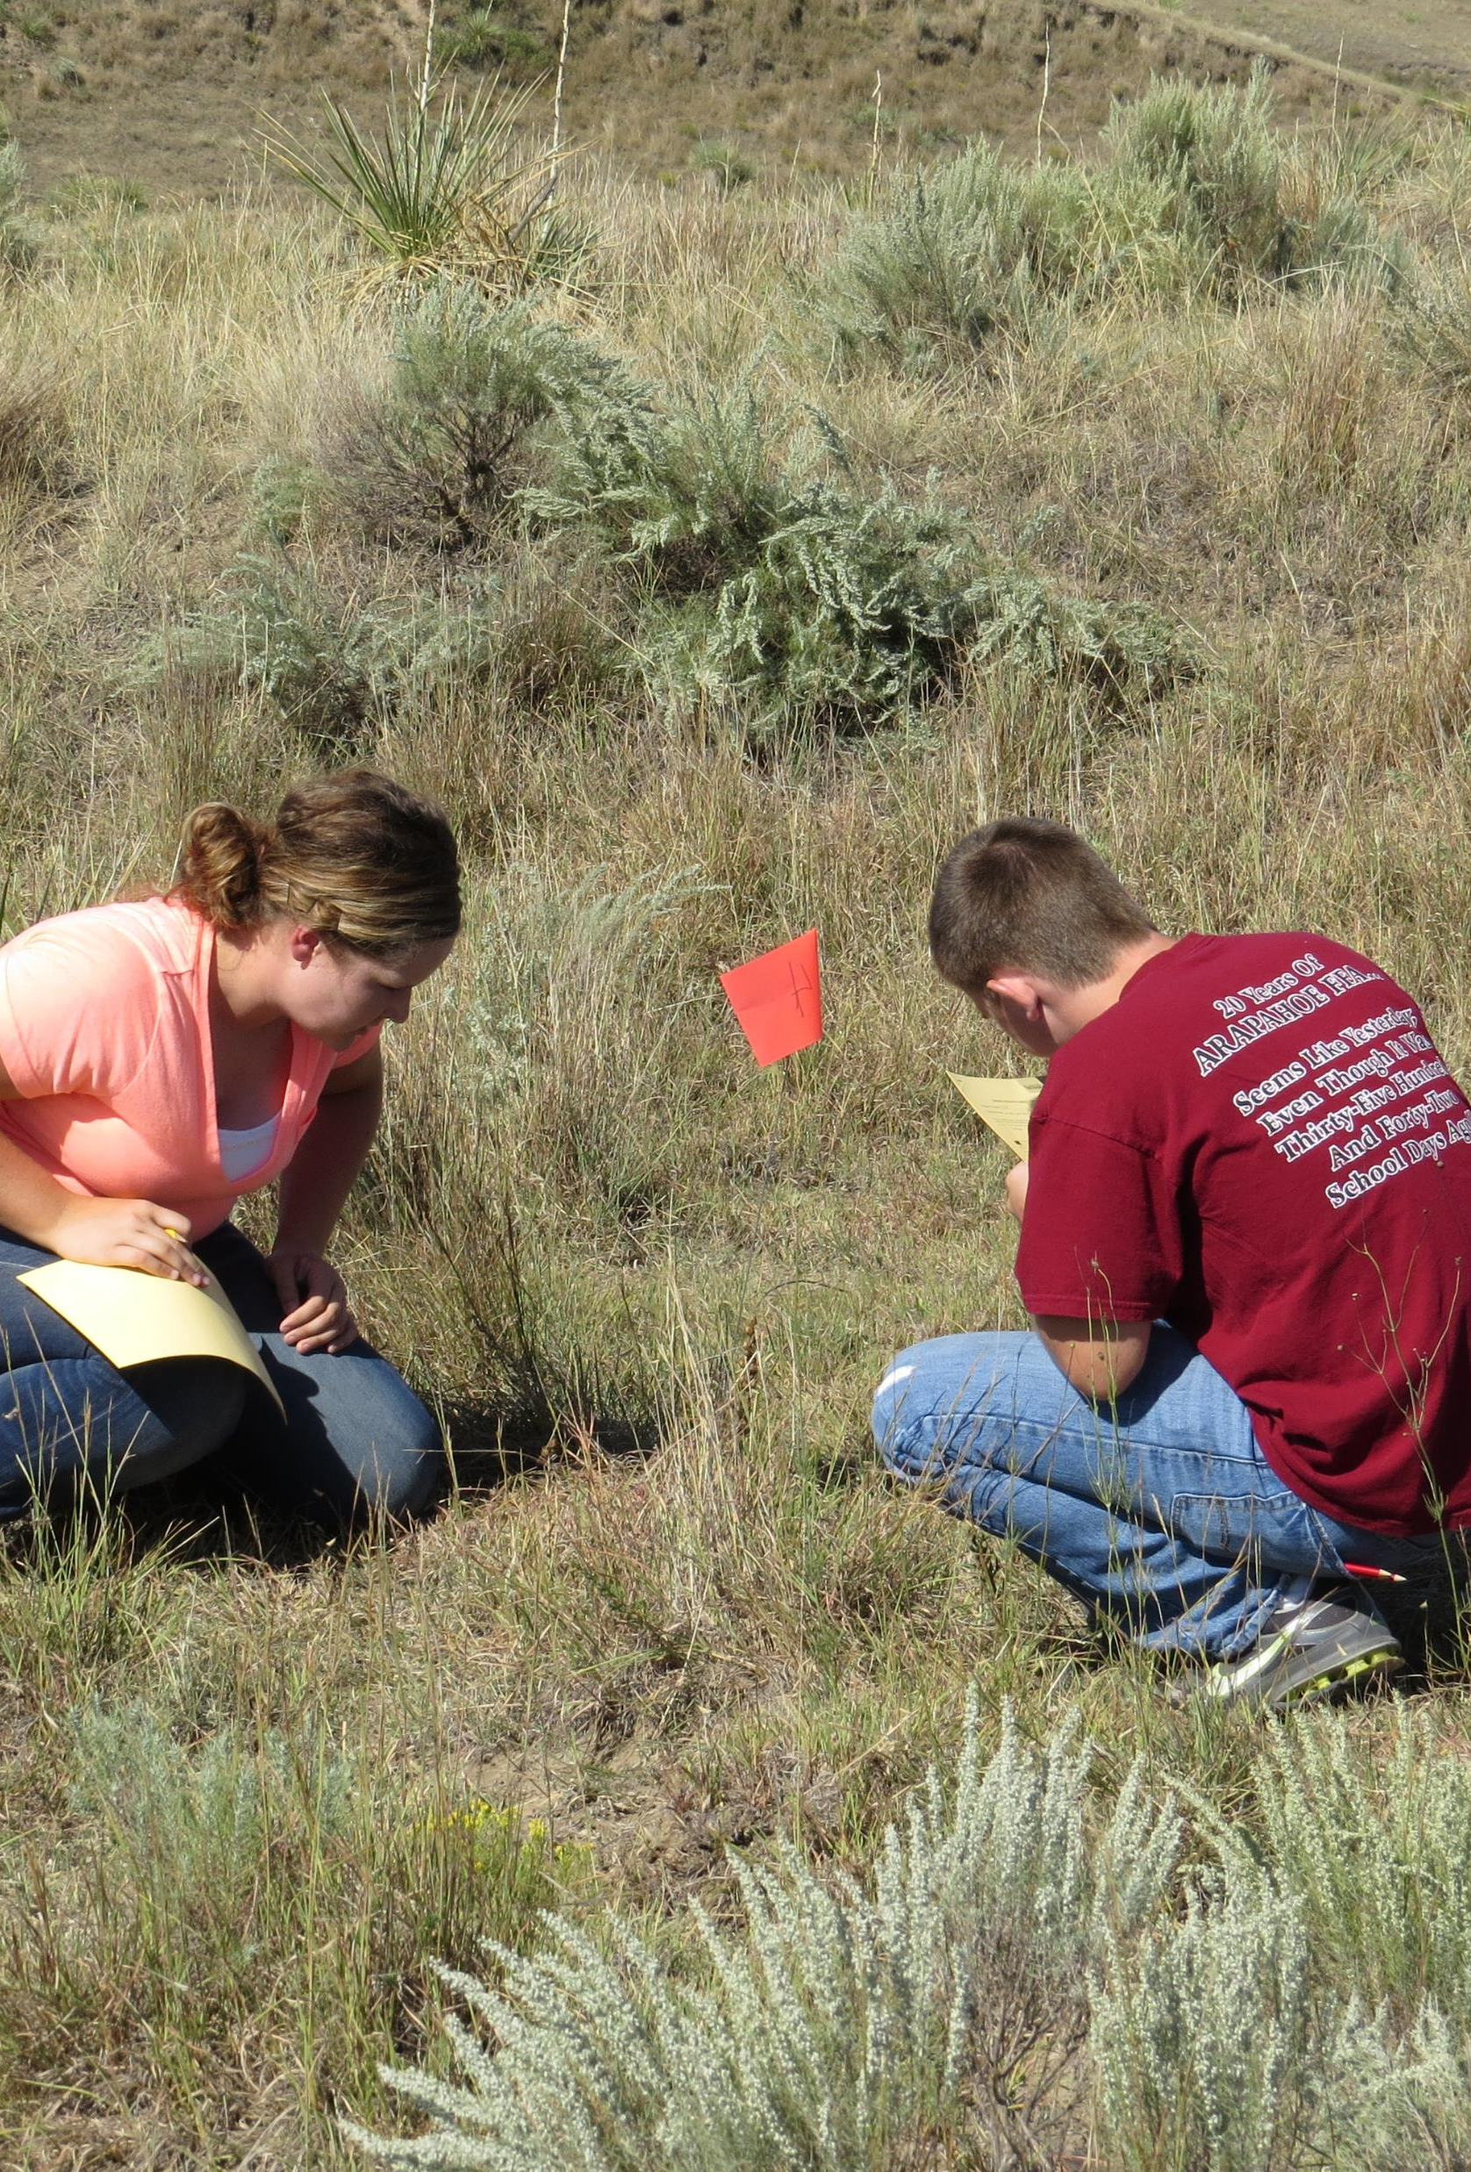
Range Judging
Today, range Judging Contests are planned by the State Range Judging Committee. This Committee is a multi-agency organization which oversees the planning and conduct of area, state and regional range judging contests held in Nebraska.
Membership in the State Range Judging Committee includes: Nebraska Extension, Natural Resource Districts, Natural Resources Conservation Service, State Department of Education, State 4-H Office, Nebraska Ag Ed Association, University of Nebraska Range Specialists, Nebraska Natural Resource Commission and members at large.
The Section Range Judging Committee Chair is one of the Co-Chairs of the State Range Judging Committee.

Slide 37
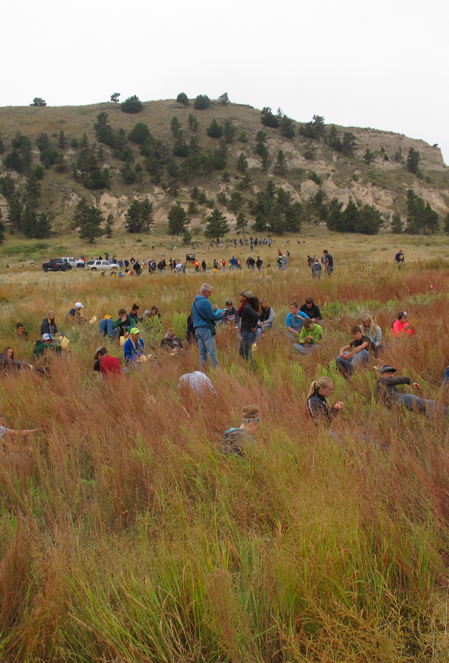
Range Judging
The Section Range Judging Committee is composed of the Chair, the Section member-at-large representative on the State Range Judging Committee, the Section member serving on the Envirothon planning committee and other persons as needed to carry out the duties of this committee.
The Section Secretary-Treasurer also serves on both the State Range Judging Committee and the Section Range Judging Committee and manages income from contest fees and pays for ribbons, cards and awards as directed by the chair of the Section Range Judging Committee.
The Nebraska Section assists in conducting contests and provides the awards presented to the winners of the contests either directly or cooperatively with other organization involved with Range Judging.
The State Range Judging Committee is currently paying for a portion of the Section’s liability insurance.

Slide 38
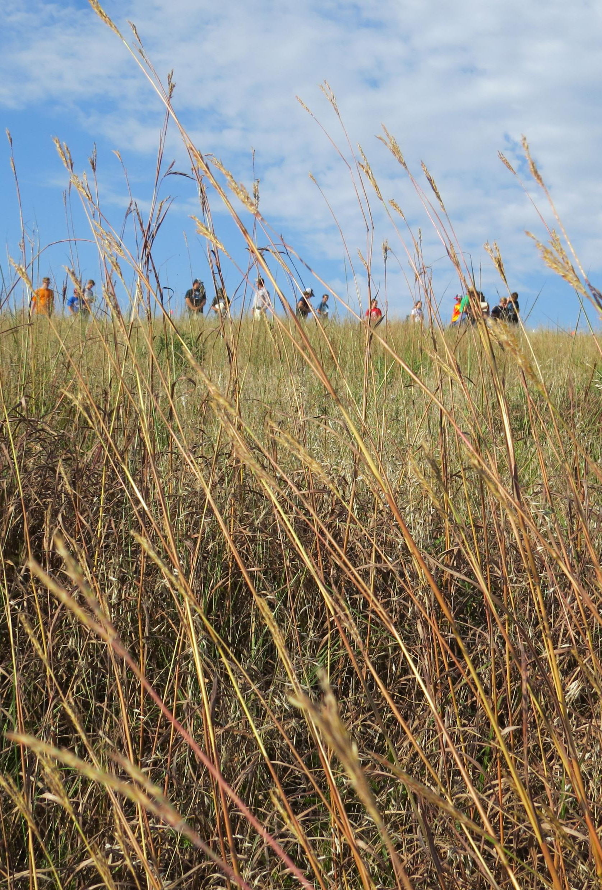
Range Judging
The duties of the Section Range Judging Committee are to:
Represent the Section in all range judging activities.
Order and distribute ribbons for area and state range judging contests.
Oversee assessment and collection of entry fees to defray cost of ribbons and awards.
Provide contest dates and locations to the Newsletter Editor for inclusion in the spring/early summer newsletter.
Provide summary of activities to Newsletter Editor for fall newsletter.
Serve as liaison with any regional range and pasture judging contests.

Slide 39
Range Research
The Range Research Committee is intended to be composed of the committee Chair and a minimum of three additional members selected by the Chair.
The membership in the committee should include at least one rancher, one individual involved in range research, and one representative from a governmental agency involved in range management in Nebraska.

Slide 40
Range Research
Committee duties include:
1. Become familiar with range management related research being conducted in Nebraska.
2. Assess research needs related to any segment of range management.
3. Report about on-going research activities and assessed needs to the membership as requested by the Section President.
4. Represent the Section in cases where the Section has legitimate input into range research discussion.
5. Liaison with the SRM Research Committee and assist actions as appropriate to the Nebraska Section.
This committee has been inactive for a number of years.

Slide 41
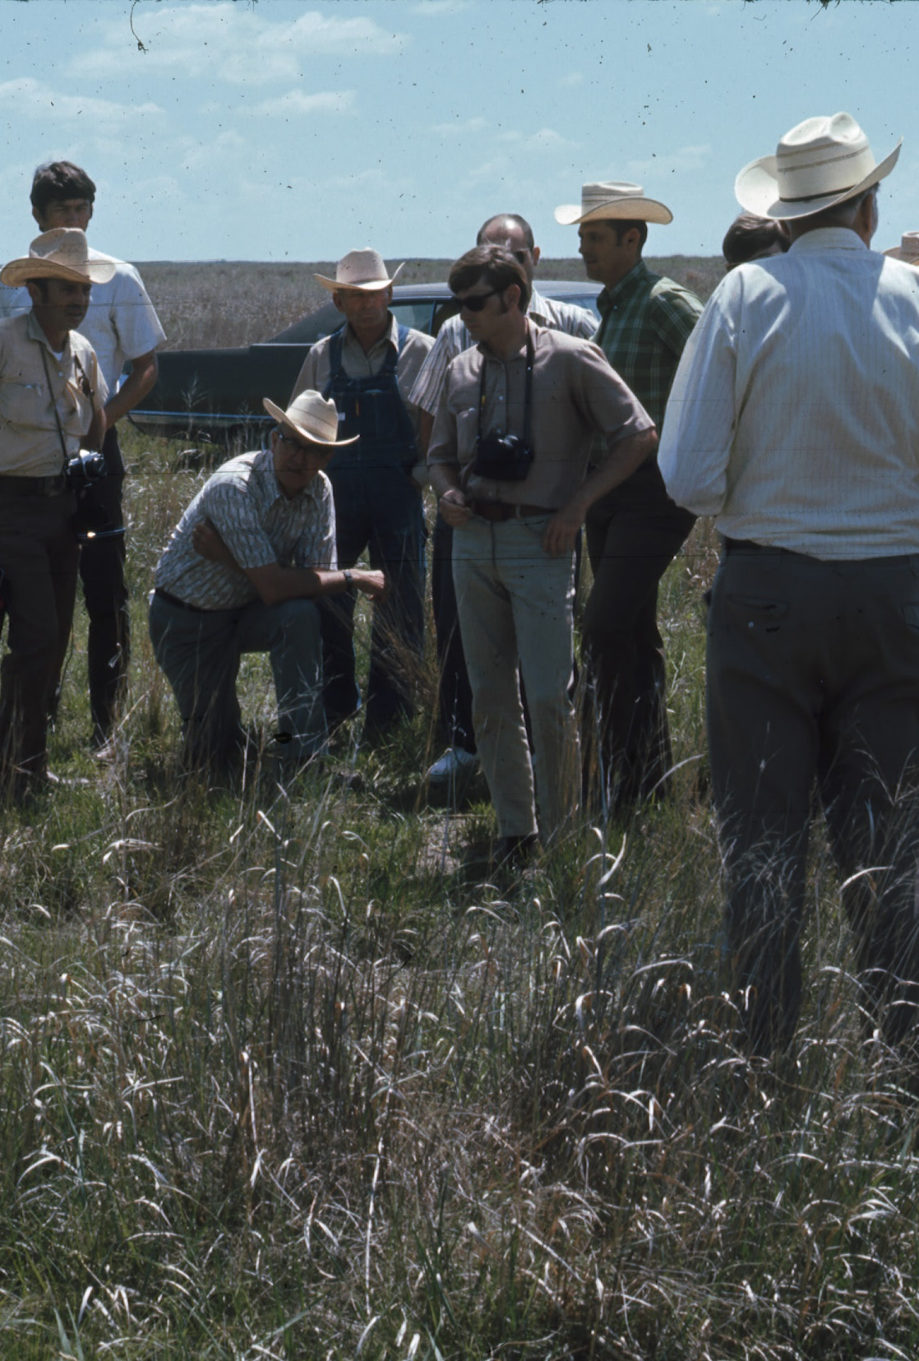
Range Tour
In the past, the Nebraska Section conducted a Summer Tour which rotated to different areas across the State and/or assisted with several area tours. Tours were conducted in different areas of the State each year and included meals and refreshments and if needed transportation.
When the Section conducts a Summer tour, the Range Tour Committee selects an area (for a State Tour) or areas (for area tours) in coordination with the Section President. Duties associated with production of a Summer Tour included:
Organize tour stops and agenda
Schedule date for the tour
Provide adequate notice information about the tour to the Section Newsletter Editor and Information and Education Chair to allow time to adequately publicize the tour.
It has been a number of years since the Section has conducted a Summer tour and the committee is inactive.

Slide 42
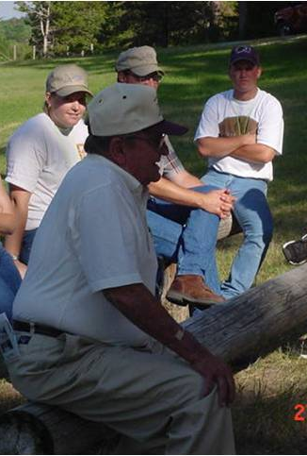
Range Youth Camp
Nebraska Range Youth Camp was organized in 1963 by members of the Nebraska Section and is one of the Section’s most longstanding activities.
The first director of Range Youth Camp was Dr. John Vallentine.
Instructors at the camp are a “who’s who” of the Section’s founders and included Dr. Vallentine, John Sautter, Don Harford, Selvester Vanderbeek, Les Messersmith, Wal Fick, Dick Dunn, Don Burzlaf, Forest Lee, Don Cox, Gerald Chaffin, Jerry Garner, Reed Hamilton, Chet Paxton, Dic, Fleming and Elmer Schrag.
From the Nebraska Section By-Laws:
“The Section … is committed to support Range Youth Camp. Much of the effort necessary to plan and conduct the camp has come through voluntary service of Section membership. It is an important activity for the Section and an essential aspect of range youth activities”.

Slide 43
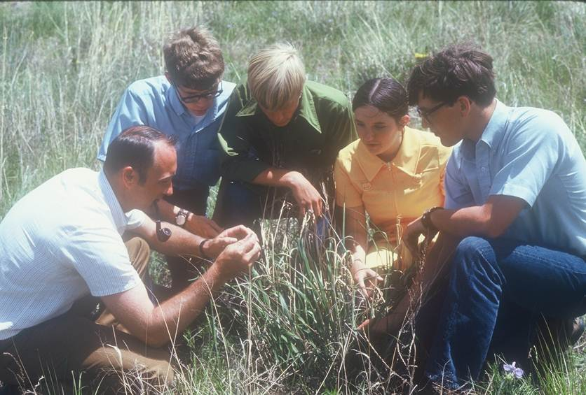
Range Youth Camp
The following description of the camp comes from a 1963 Section Newsletter:
“The program will emphasize range land and livestock management and include field trips to ranches and research projects, range judging and range demonstrations and educational films. Training will also be given in leadership in directing youth educational programs in range management. Professional opportunities in range management will be presented. Recreation and sports will be an important part of the camp.”

Slide 44
Range Youth Camp
Important dates in Range Youth Camp History:
1963: The first camp was sponsored by Nebraska Section SRM
1970: The first girl, Irene Graves, attended Range Camp.
1976-1980: The Old West Regional Commission Range Program provided funds for camp.
1976: The Section began providing financial awards to the two top students to be used toward their attendance at High School Youth Forum at the International SRM Annual Meeting.
1980: Ranch sponsorship was initiated with 8 ranches providing financial support of camp and the use of their brands. Crew competitions were incorporated into camp activities.
1980: Registration fees and camp sponsorships were first used to provide travel expenses for the top students to attend High School Youth Forum.

Slide 45
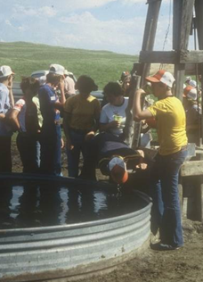
Range Youth Camp
The Range Youth Camp Committee is composed of a Chair who serves as the Camp Director and other persons as necessary to conduct the Camp. In recent years, the directorship of the Camp has been conducted by two Co-Chairs.
The Director(s) should participate as an instructor and/or crew boss prior to their directorship. The Director(s) should be designated by the President two years in advance and may be reappointed to ensure continuity of the camp.
The format for the camp is passed on by experience. Arrangements should be make to provide the experience for the next individual to assume Directorship of the camp.

Slide 46
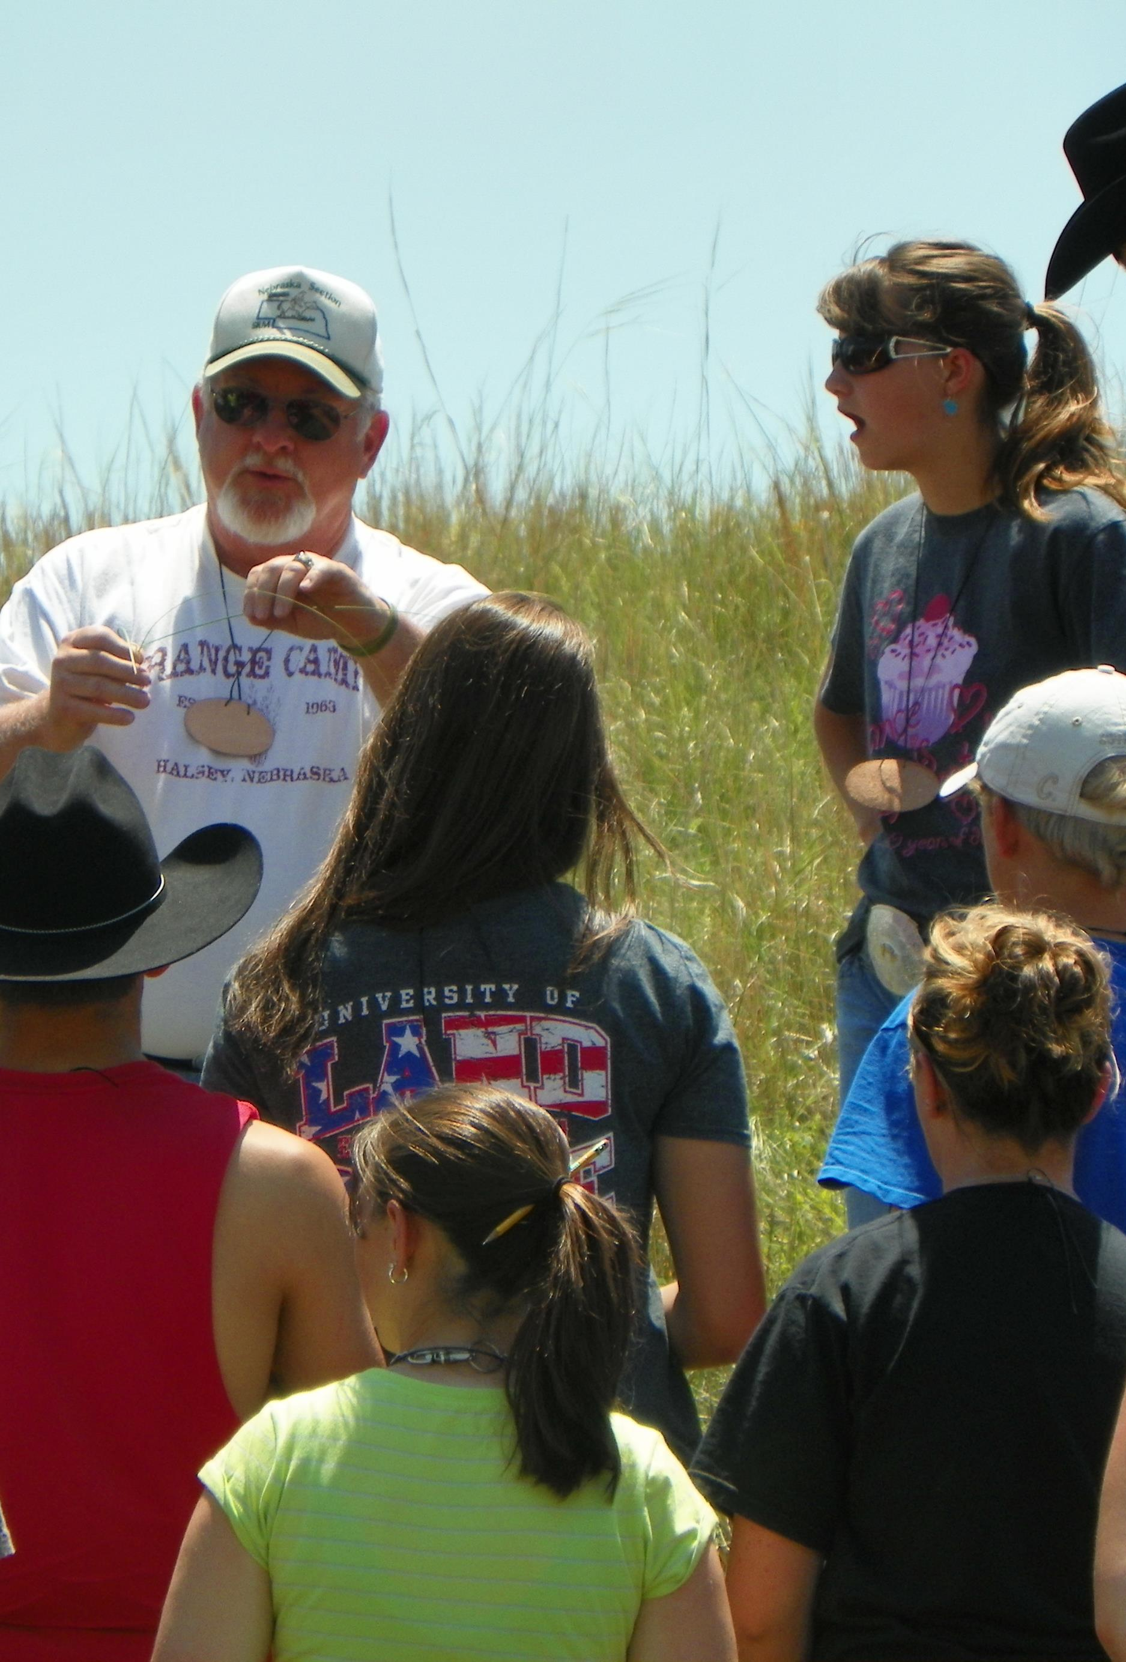
Range Youth Camp
Duties of the Director include:
Planning of the Camp, which includes reserving facilities, obtaining speakers and crew bosses, lining up volunteers to set up the range judging contest, organizing a ranch tour and planning recreational activities.
Provide assistance and guidance to the top campers who give a presentation at the Section Annual Meeting and the camper(s) chosen to participate in High School Youth Forum at the International SRM Annual Meeting.
Obtain the assistance of committee members in planning and organization of the camp.

Slide 47
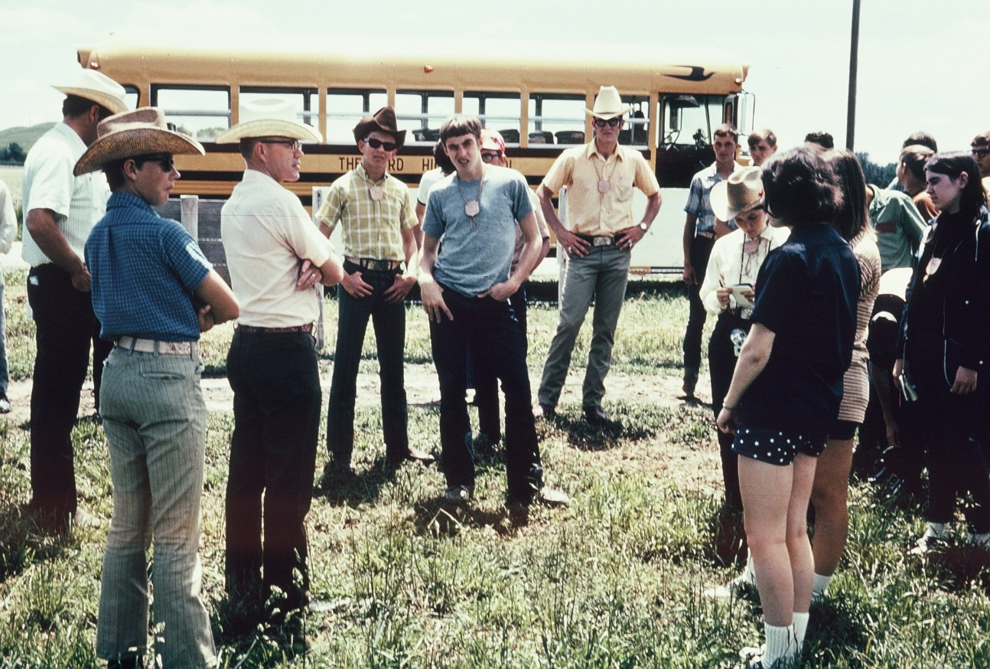
Range Youth Camp
From the Section By-laws:
“The camp committee is responsible for financial arrangements related to camp function.
The fee should cover the cost of camp, awards, and costs of sending campers to the High School Youth Forum. The number of individuals sent to HSYF will depend upon the location (and therefore cost) of transportation and lodging.”
A sound budget which includes a line item for HSYF is essential to meet this mandate.
In the past at least one and up to three individuals have been sent to HSYF by the Nebraska Section.

Slide 48
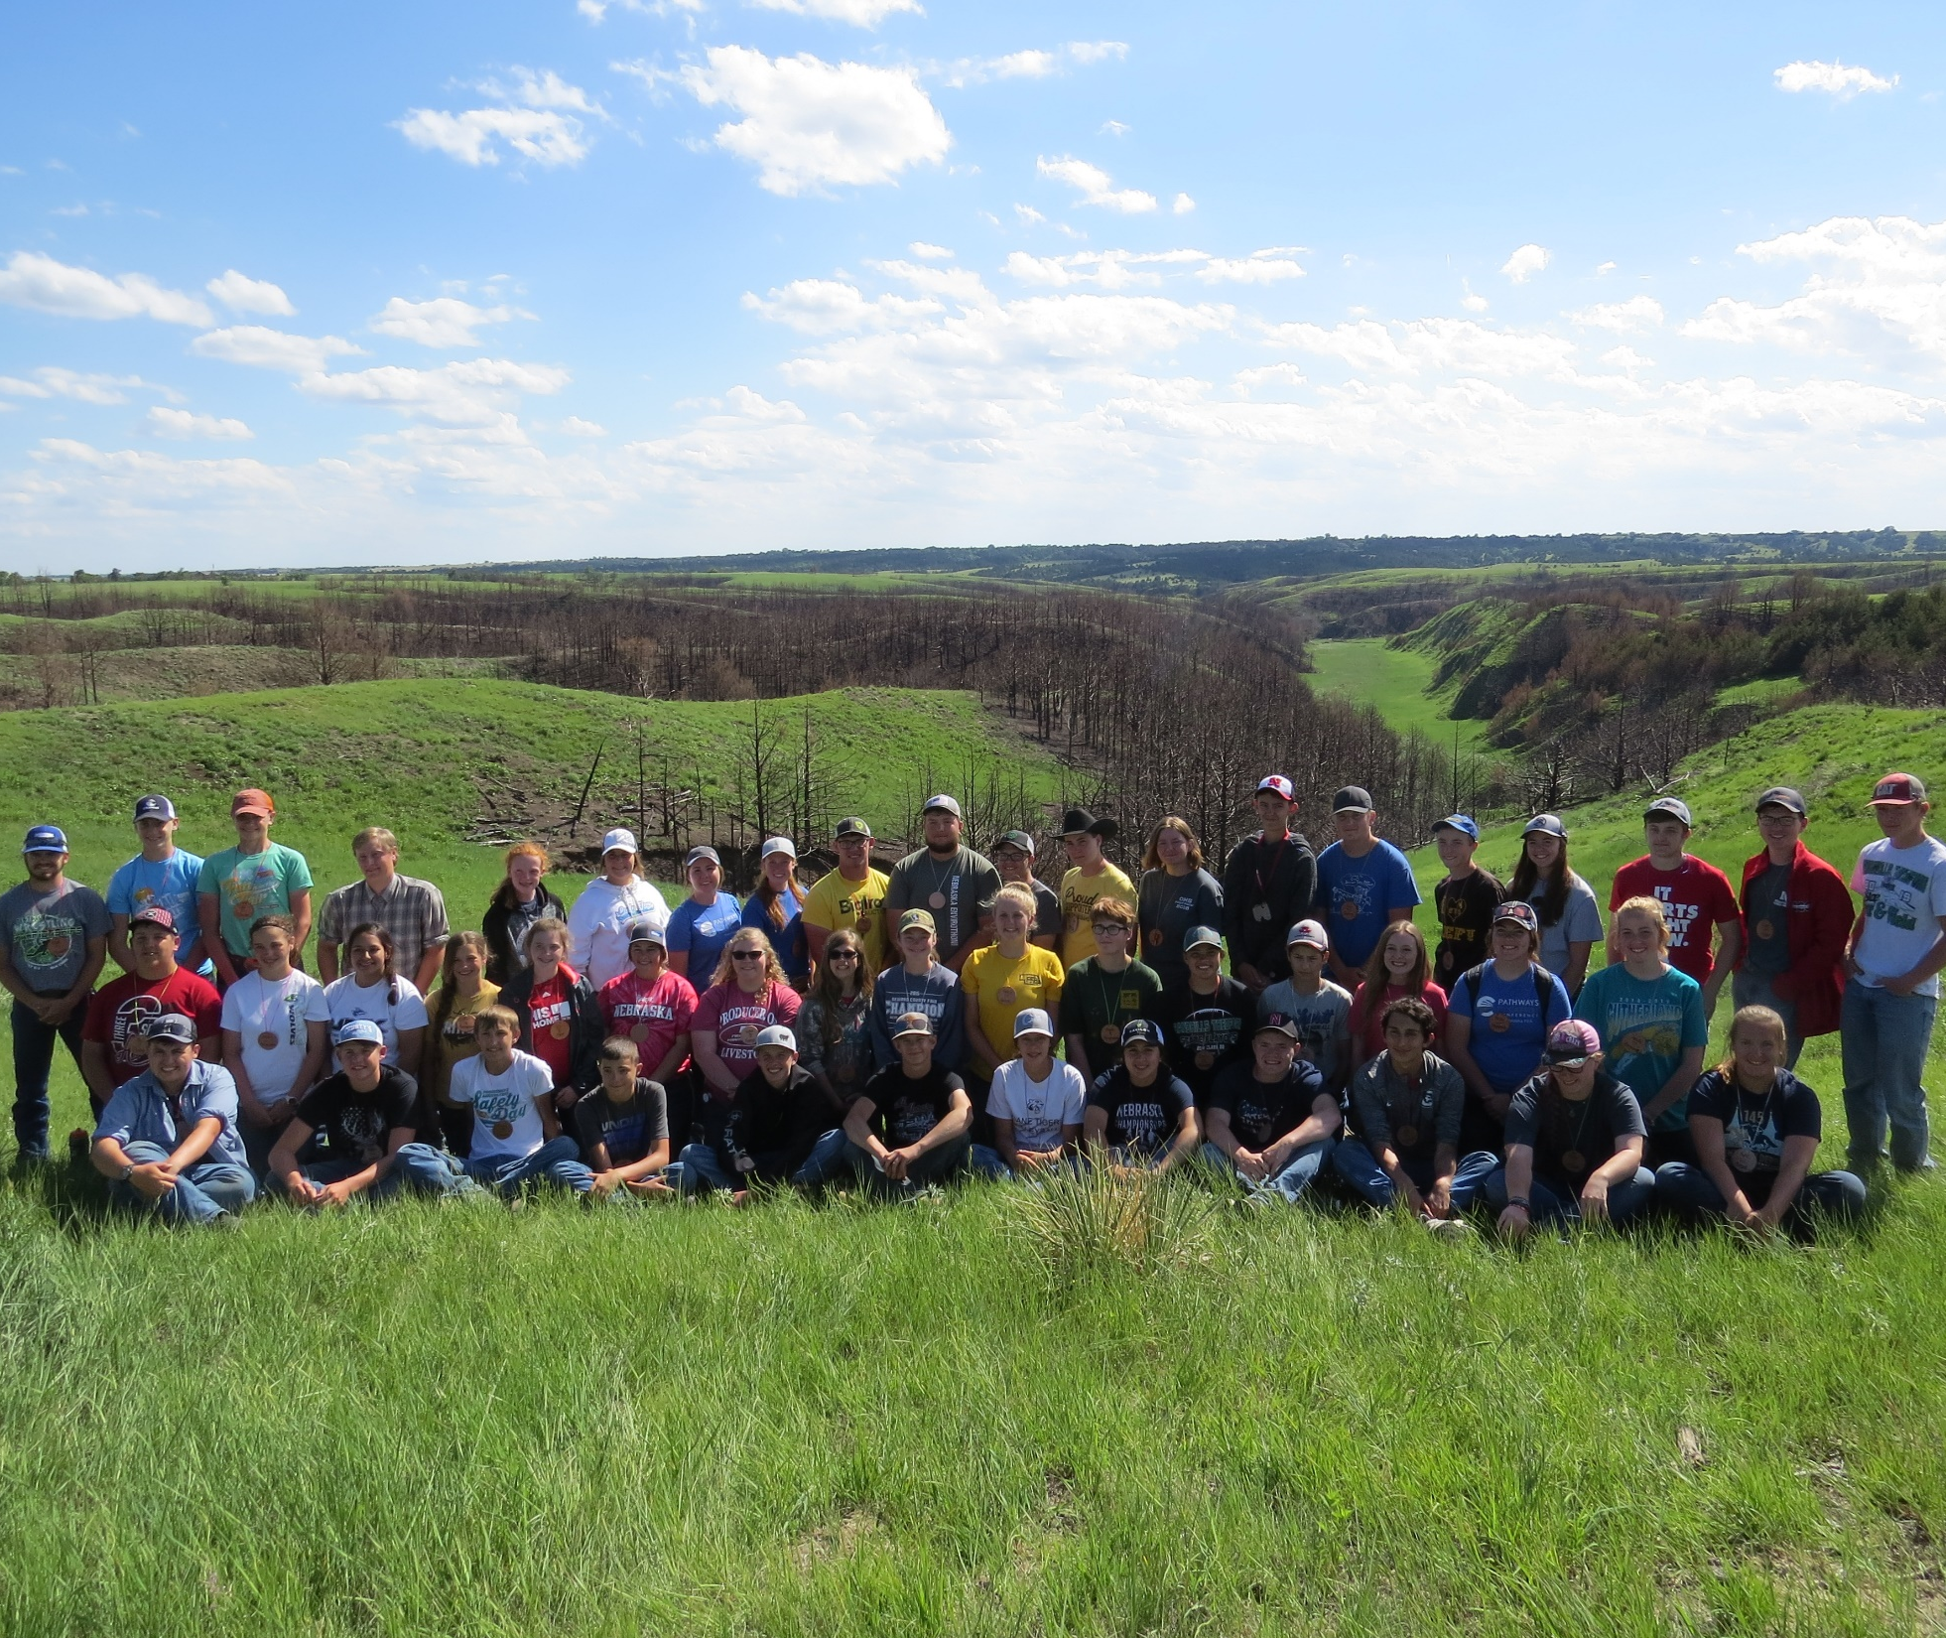
Range Youth Camp
Range Youth Camp is one of the major activities covered by the Section’s liability insurance policy. The liability insurance covers members of the Section while carrying out Section activities.
If one (or both) of the co-directors are not Section members, the liability policy should be checked to determine whether these individuals would still be covered by the policy.

Slide 49
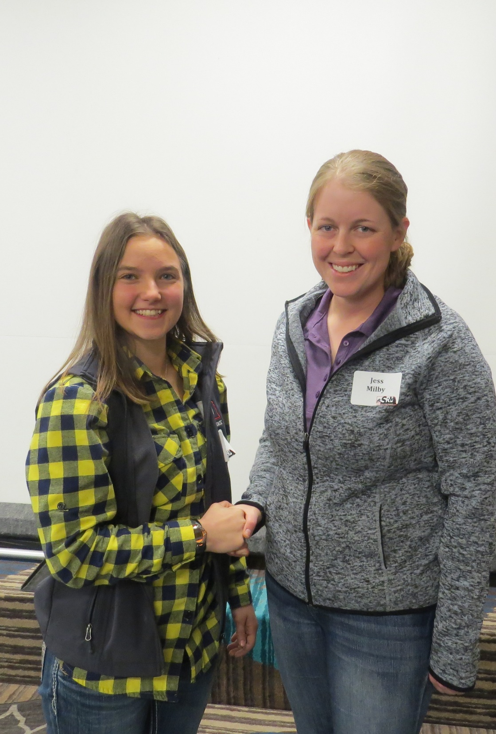
Scholarships
The Scholarship Committee consists of the Chair and at least two other persons. The Chair should inform the President of the members of the Committee.
The Committee duties include:
Solicit and review applications in a timely fashion and select recipient of scholarship(s).
Prepare materials that can be provided to interested persons regarding the scholarship.
Verify scholarship value with the Investment Committee before advertising the scholarship for the year.
Notify the Investment Committee Chair of the identity of the scholarship winner(s) prior to Annual Meeting.
The Chair will present the scholarship to the winner at the annual meeting.
Provide biographical information necessary to create a press release on each winner and forward this information to Chair of the I&E Committee prior to the Annual Meeting.

Slide 50
Student Affairs
The members of the Student Affairs Committee should be composed of a Committee Chair, Chair of the Range Youth Camp Committee, Chair of the Range Judging Committee, Chair of the Envirothon Committee, two members involved in teaching and Presidents of UN-L and CSC Range Clubs.
Duties of the Committee are:
Coordinate student activities for the section including Range Youth Camp, Range Judging, Envirothon, FFA and 4-H activities.
Coordinate HSYF, University Student Conclave and Graduate Student presentations at the Section’s Annual Meeting.
Develop new or improved student related activities.
Serve as Liaison with SRM Student Activities Committee.
The NE Section Student Affairs Committee should coordinate and provide guidance for all student related activities in the Nebraska Section.

Slide 51
NE Section Website
The Section Website is currently maintained by Doreen Brown Butterfield.
Committee members and council members, should ensure that information on the website is current by providing information to Doreen on a timely basis.
Annual meeting, range judging information, range camp and council members/committee chairs are especially important and should be updated regularly.

Slide 52
NE Section Display
The Nebraska Section Display is maintained by the I&E Chairperson and is available for local range related events.
To reserve the display and to tailor the existing display to local events, contact the I&E Chair.

Slide 53
